Slide 1

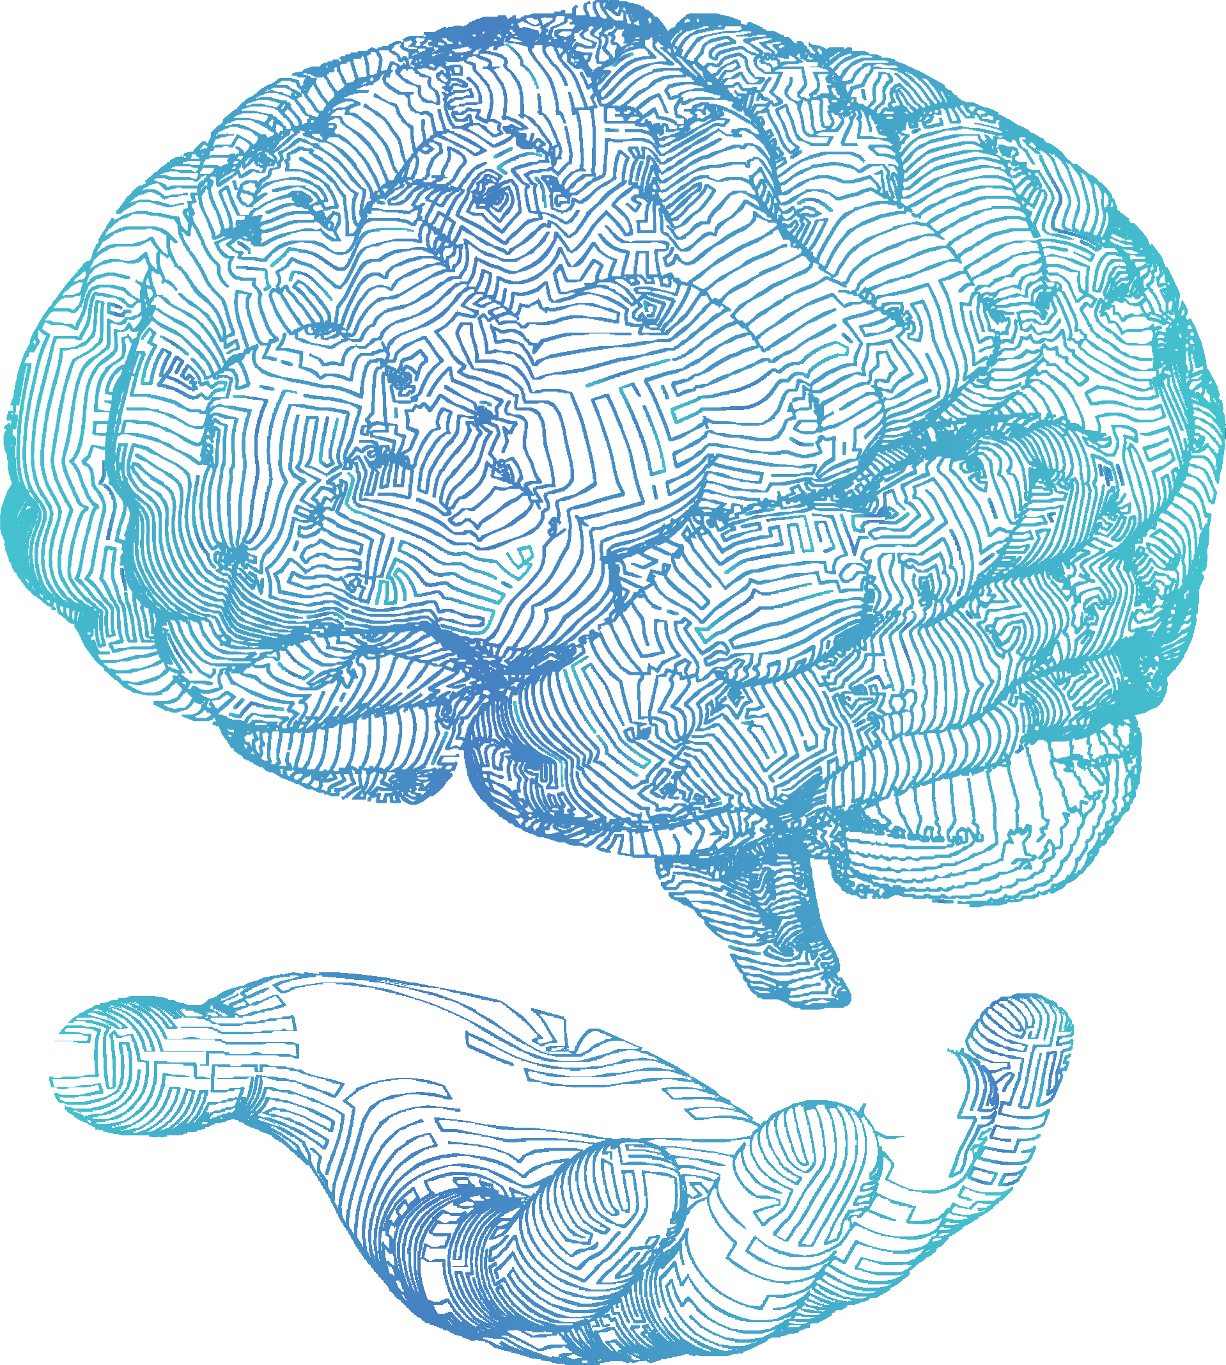







DEMYSTIFYING AI
Tim Miller
School of Electrical Engineering and Computer Science
The University of Queensland, Australia E: timothy.miller@uq.edu.au
T: @tmiller_uq W: https://uqtmiller.github.io/

Slide 2
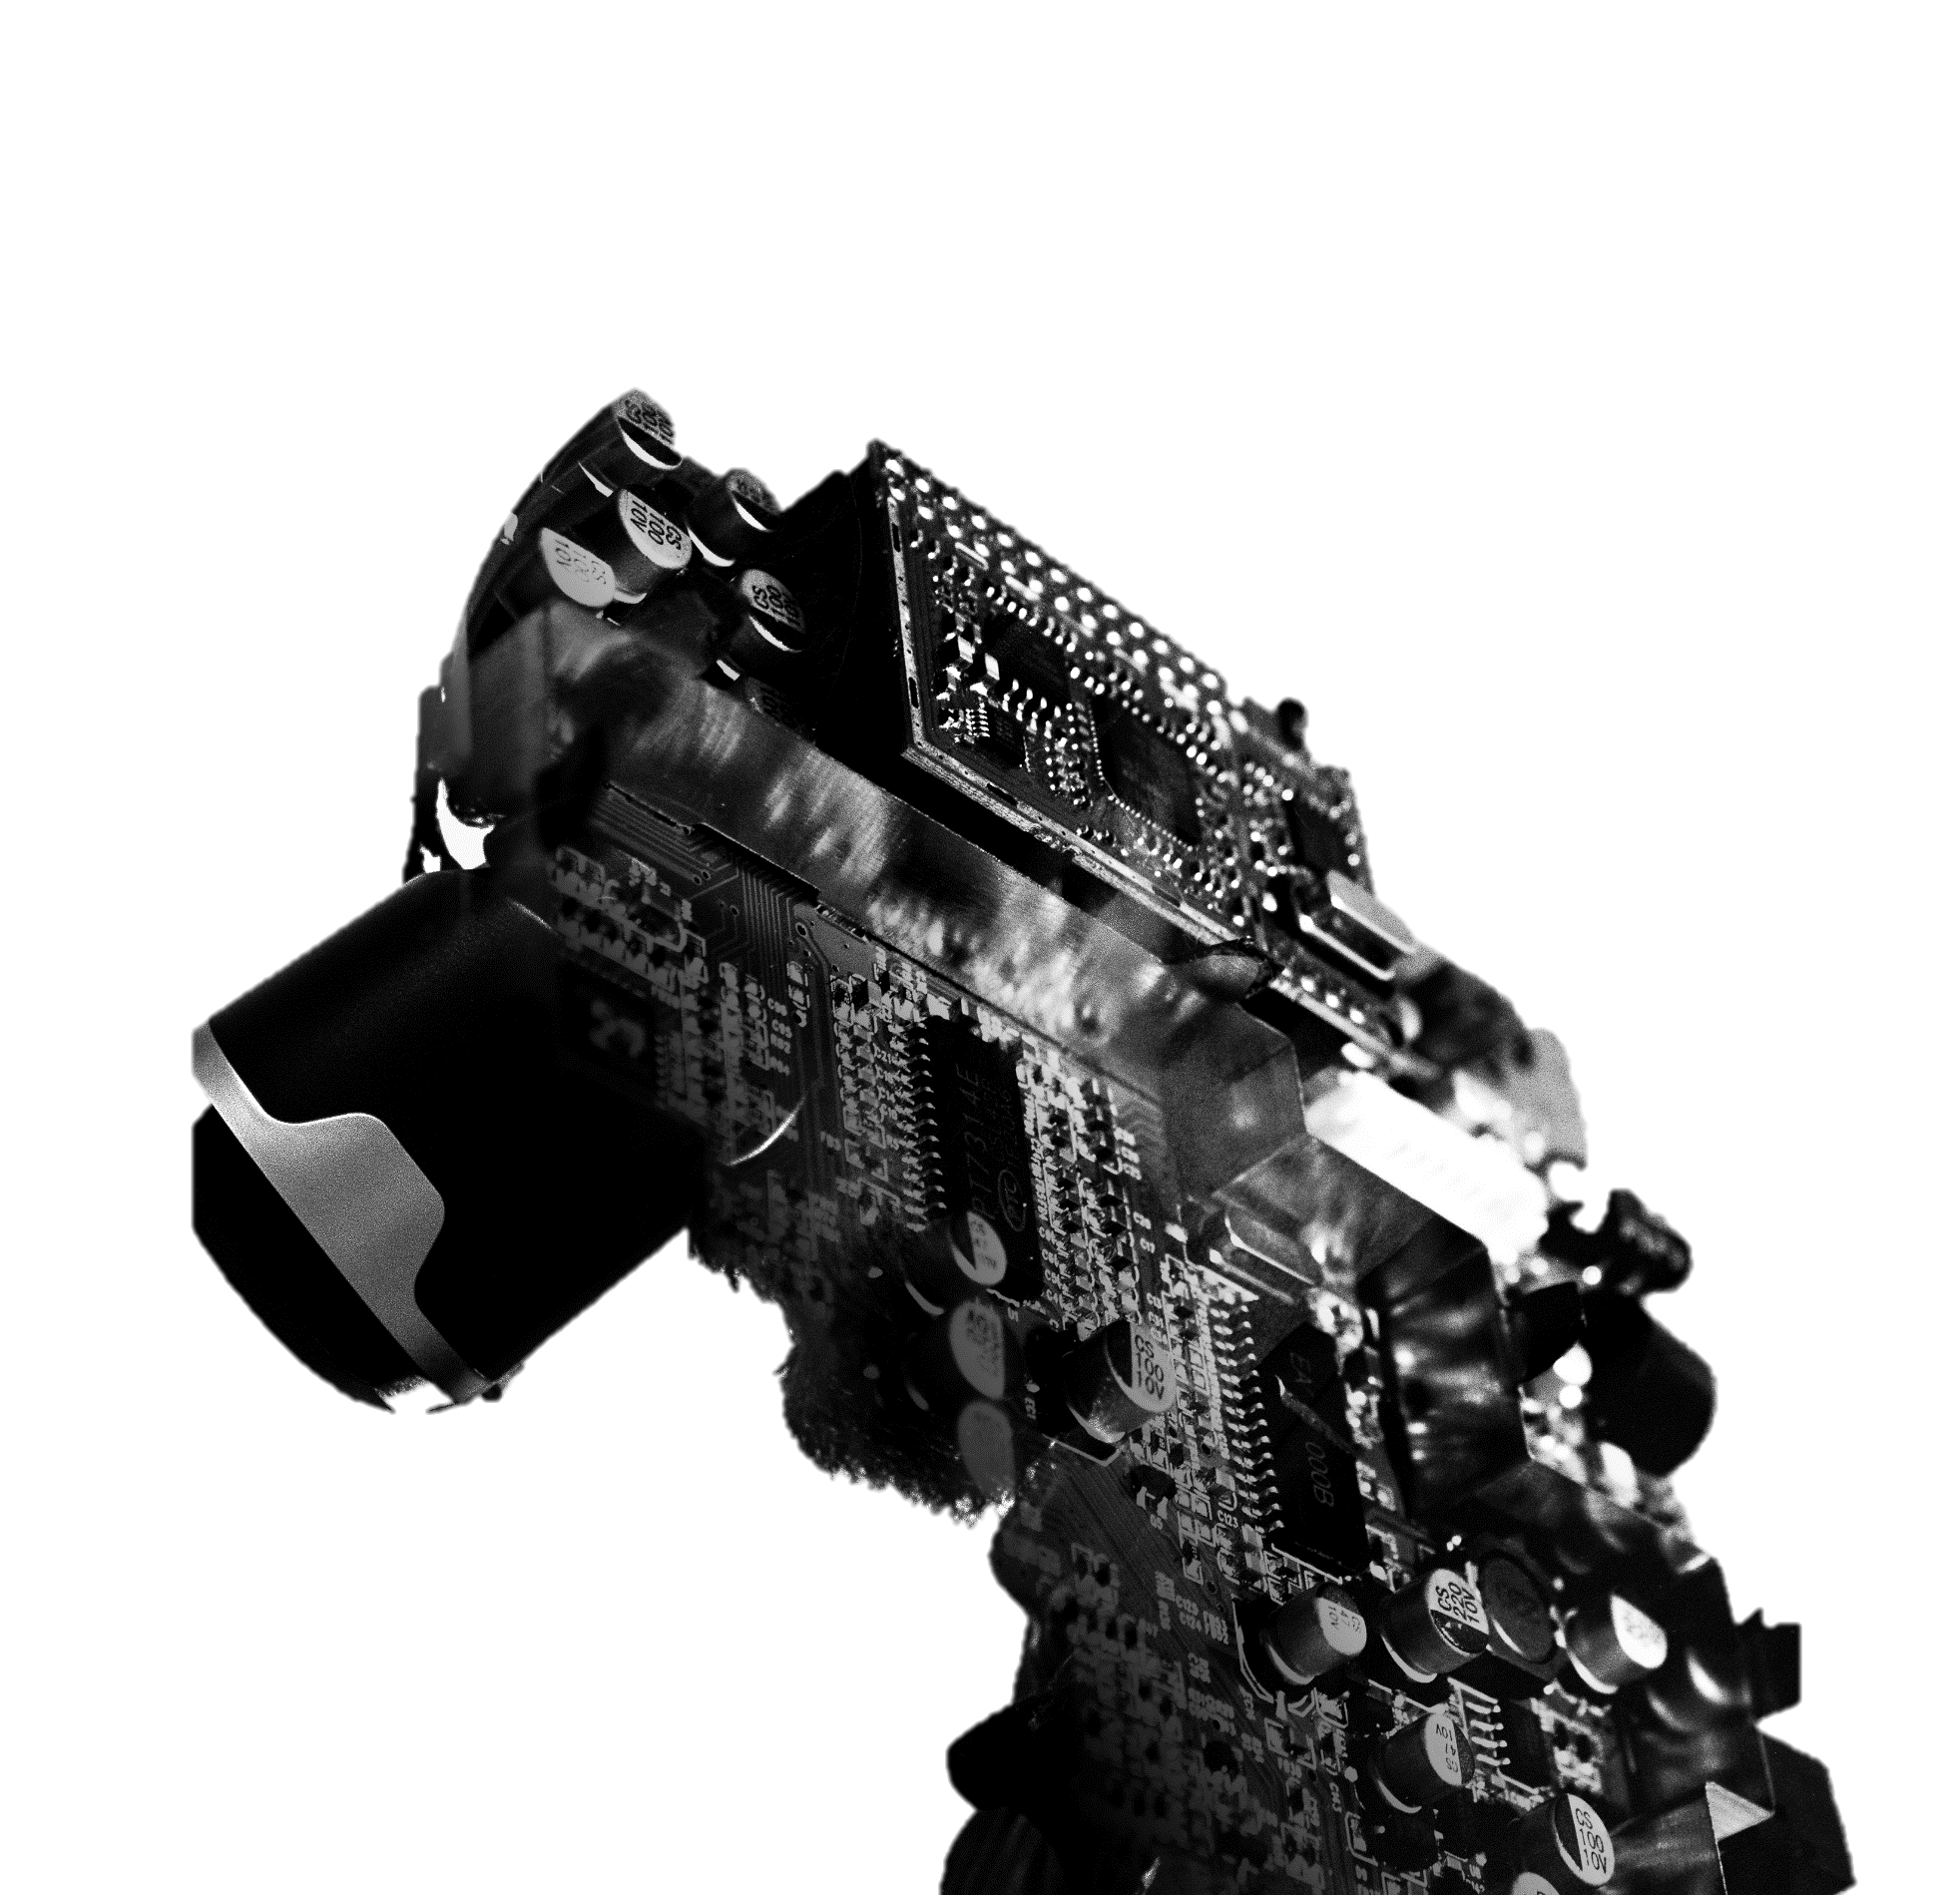
DEMYSTIFYING ARTIFICIAL INTELLIGENCE
Tim Miller
School of Electrical Engineering and Computer Science
The University of Queensland, Australia E: timothy.miller@uq.edu.au
T: @tmiller_uq W: https://uqtmiller.github.io/
Notes:
Title: Demystifying Artificial Intelligence
Speaker: Tim Miller, Professor of Artificial Intelligence, The University of Queensland
Abstract: In this talk, I will answer the questions: What is artificial intelligence really? How does it work? How do large language models like ChatGPT work? What can artificial intelligence do and not do? What opportunities and risks are there for using it? This session will be interactive and will be suitable for people with no background in artificial intelligence or computing.

Slide 3
TALK OUTLINE
What is (modern) artificial intelligence?
How does it work?
What are some great (and not-so-great) applications of artificial intelligence?
What are some current issues of interest?

Slide 4
TALK OUTLINE
What is (modern) artificial intelligence?
What are some current issues of interest?

Slide 5

WHAT IS
ARTIFICIAL
INTELLIGENCE?

Slide 6

WHAT IS ARTIFICIAL INTELLIGENCE?

Slide 7

WHAT IS ARTIFICIAL INTELLIGENCE?
“To make computer programs that can solve problems and achieve goals in the world as well as humans”
JOHN MCCARTHY (1956)
“Computer science is writing programs that can automatically solve problems.
“Artificial intelligence is writing programs that
can automatically write programs to automatically solve problems”
TIM MILLER (2024)

Slide 8



COMPUTER SCIENCE VS A.I.
Notes:
Use transitions. Requires one image to be broken apart

Slide 9
COMPUTER SCIENCE VS A.I.
Notes:
Use transitions. Requires one image to be broken apart

Slide 10

MACHINE LEARNING
y = ax + b
350
300
LOAN AMOUNT ($,000s)
250
200
150
100
50
0
0
100
200
300
400
500
600
INCOME ($,000s)

Slide 11
MACHINE LEARNING
y = ax + b
350
300
HEALTH
250
200
150
100
50
0
0
2
4
6
8
10
12
SLEEP (Hrs)

Slide 12
MACHINE LEARNING
y = ax + b
350
300
LOAN AMOUNT ($,000s)
250
200
150
100
50
0
0
100
200
300
400
500
600
INCOME ($,000s)

Slide 13
MACHINE LEARNING
y = ax² + b
350
300
HEALTH
250
200
150
100
50
0
0
2
4
6
8
10
12
SLEEP (Hrs)

Slide 14
MACHINE LEARNING
y = ax² + b
350
300
LOAN AMOUNT ($,000s)
250
200
150
100
50
0
0
100
200
300
400
500
600
INCOME ($,000s)

Slide 15








MACHINE LEARNING
y = ax + by + c
HEALTH
400
300
200
100
0
0
4
2
3
4
2
6
SLEEP (Hrs)
8
1
EXERCISE (Hrs)
10
12
0

Slide 16
MACHINE LEARNING
y = ax + by + c
LOAN AMOUNT ($,000S)
400
300
200
100
0
0
400
100
300
200
200
300
400
100
500
600
0
ASSETS ($,000S)
INCOME ($,000S)

Slide 17
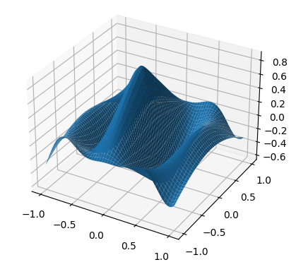
MACHINE LEARNING

Slide 18
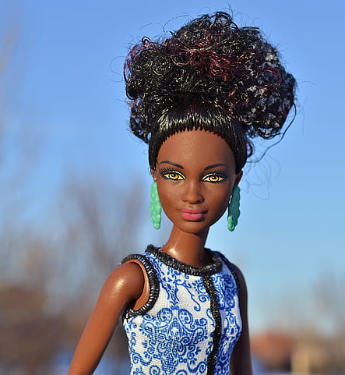
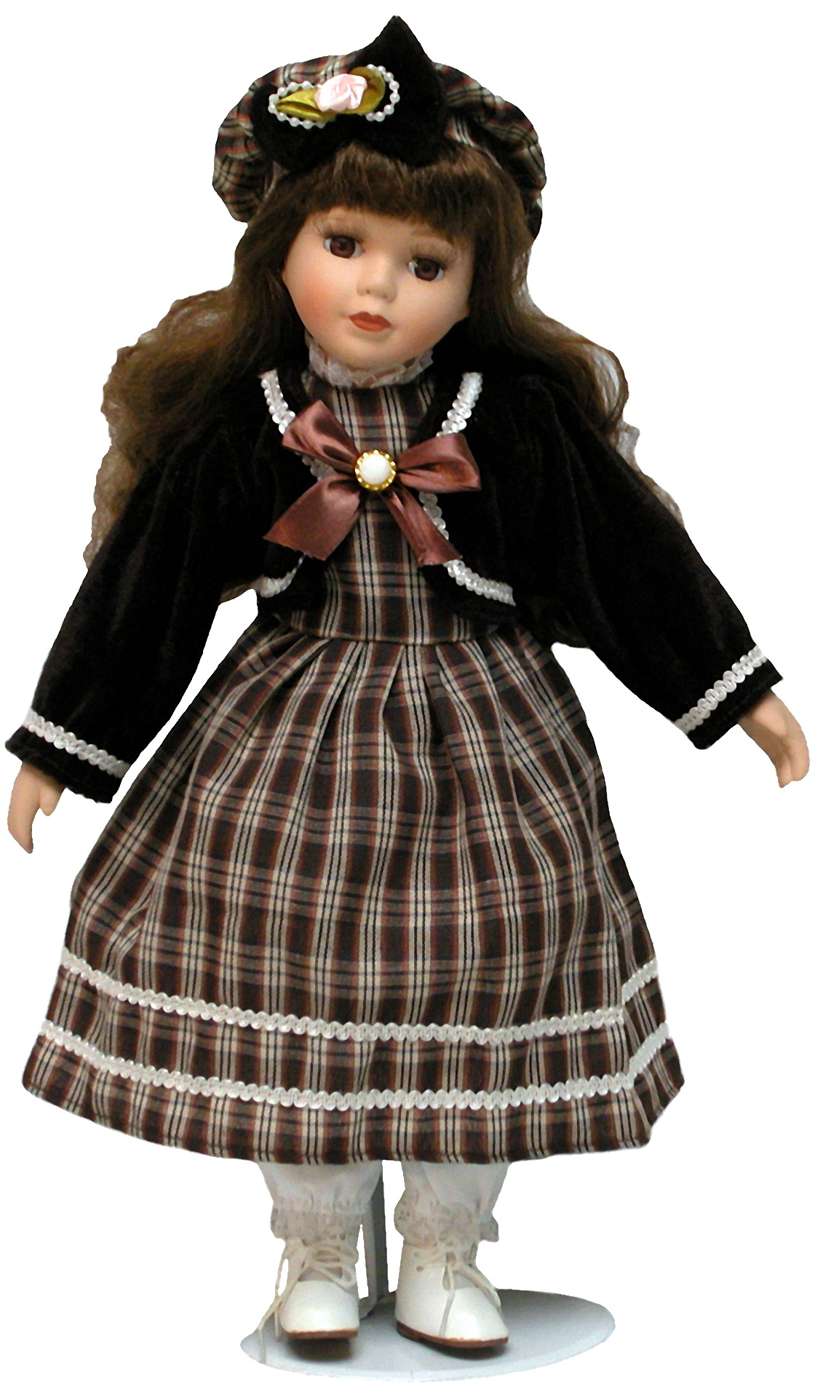
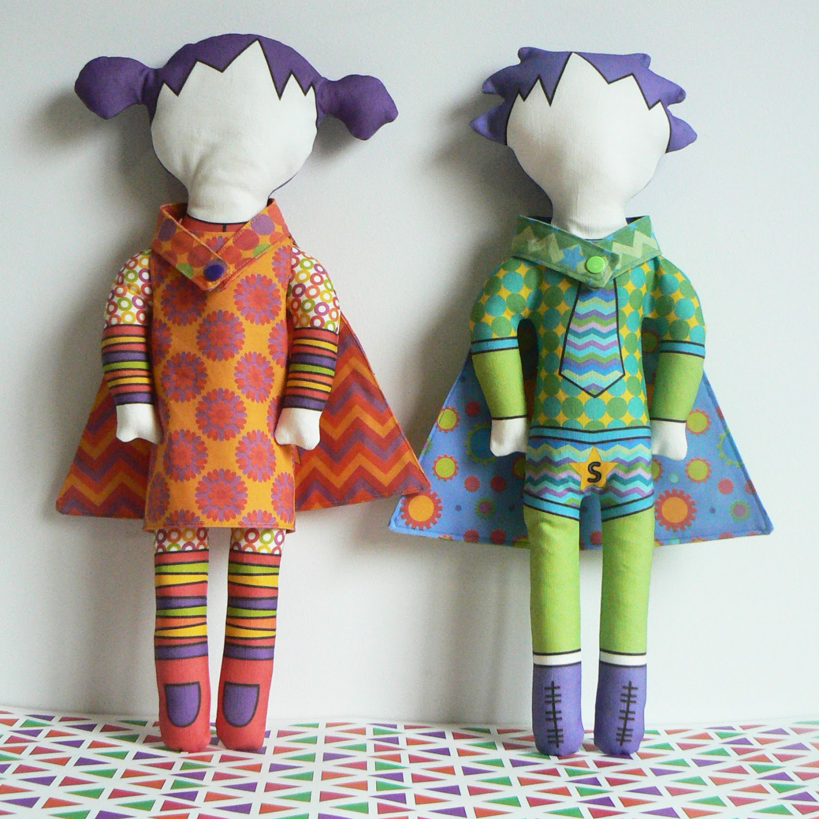
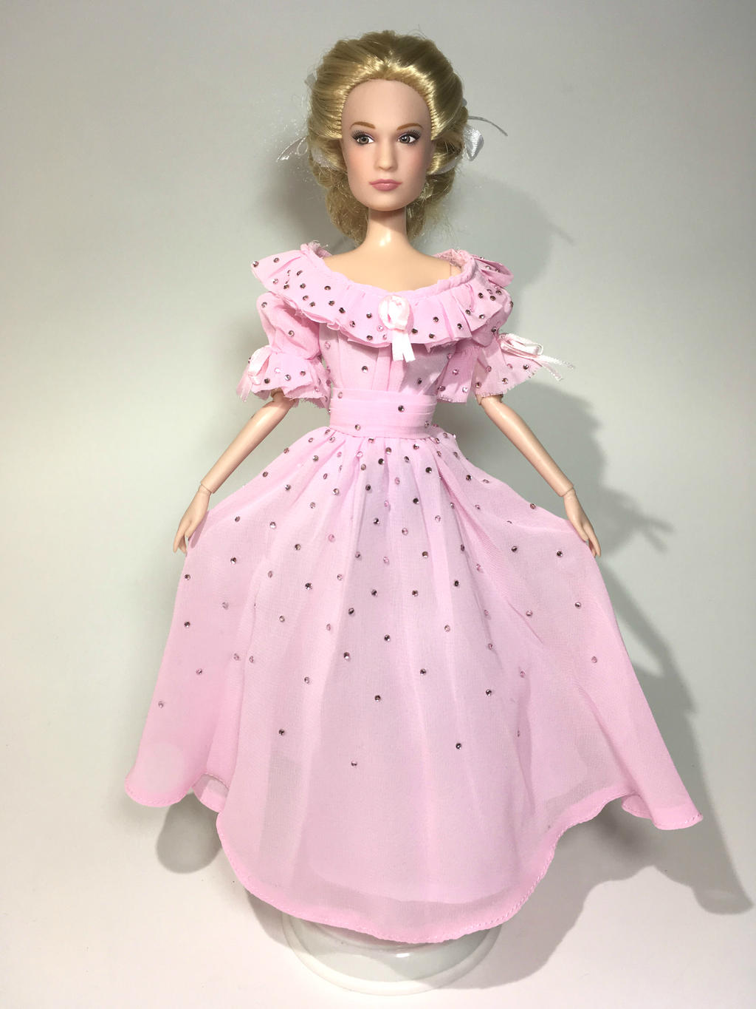
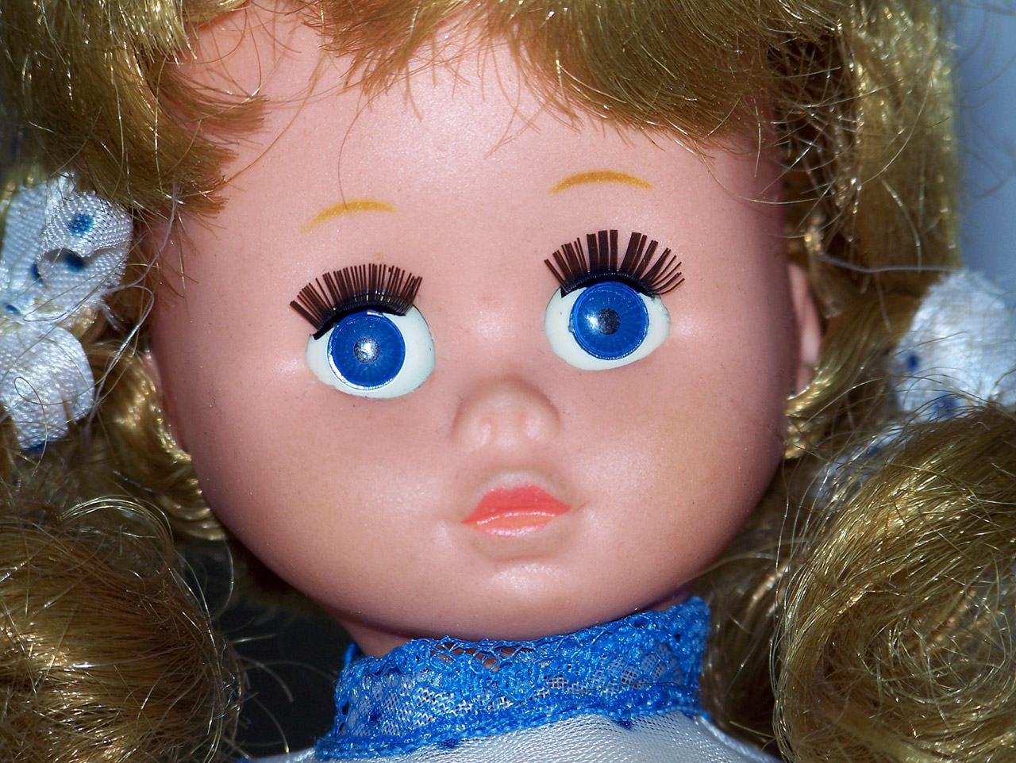
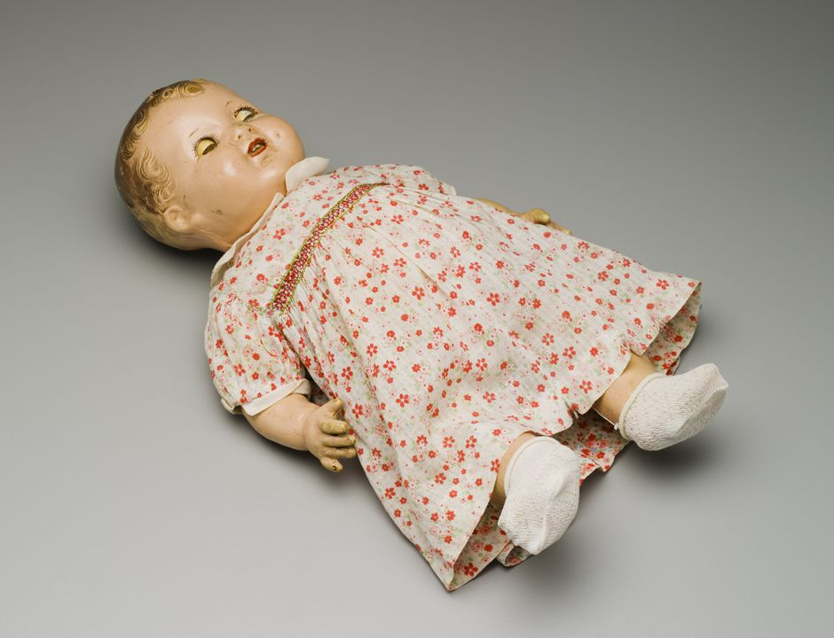
WHY MACHINE LEARNING?
This Photo by Unknown Author is licensed under CC BY-NC
This Photo by Unknown Author is licensed under CC BY-NC-ND

Slide 19
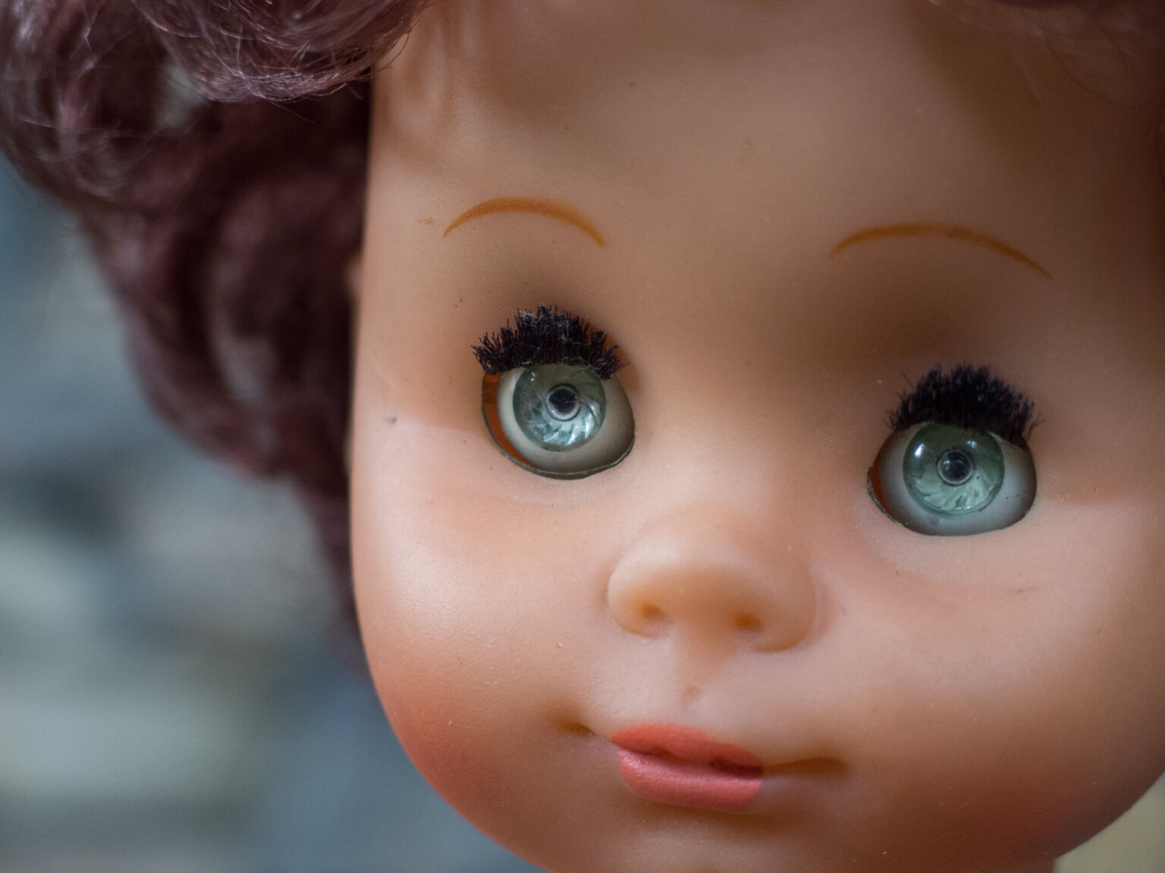
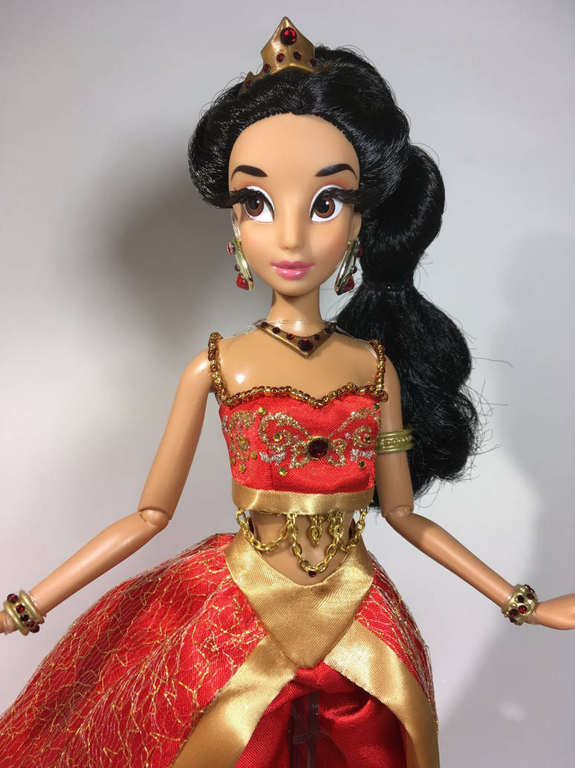
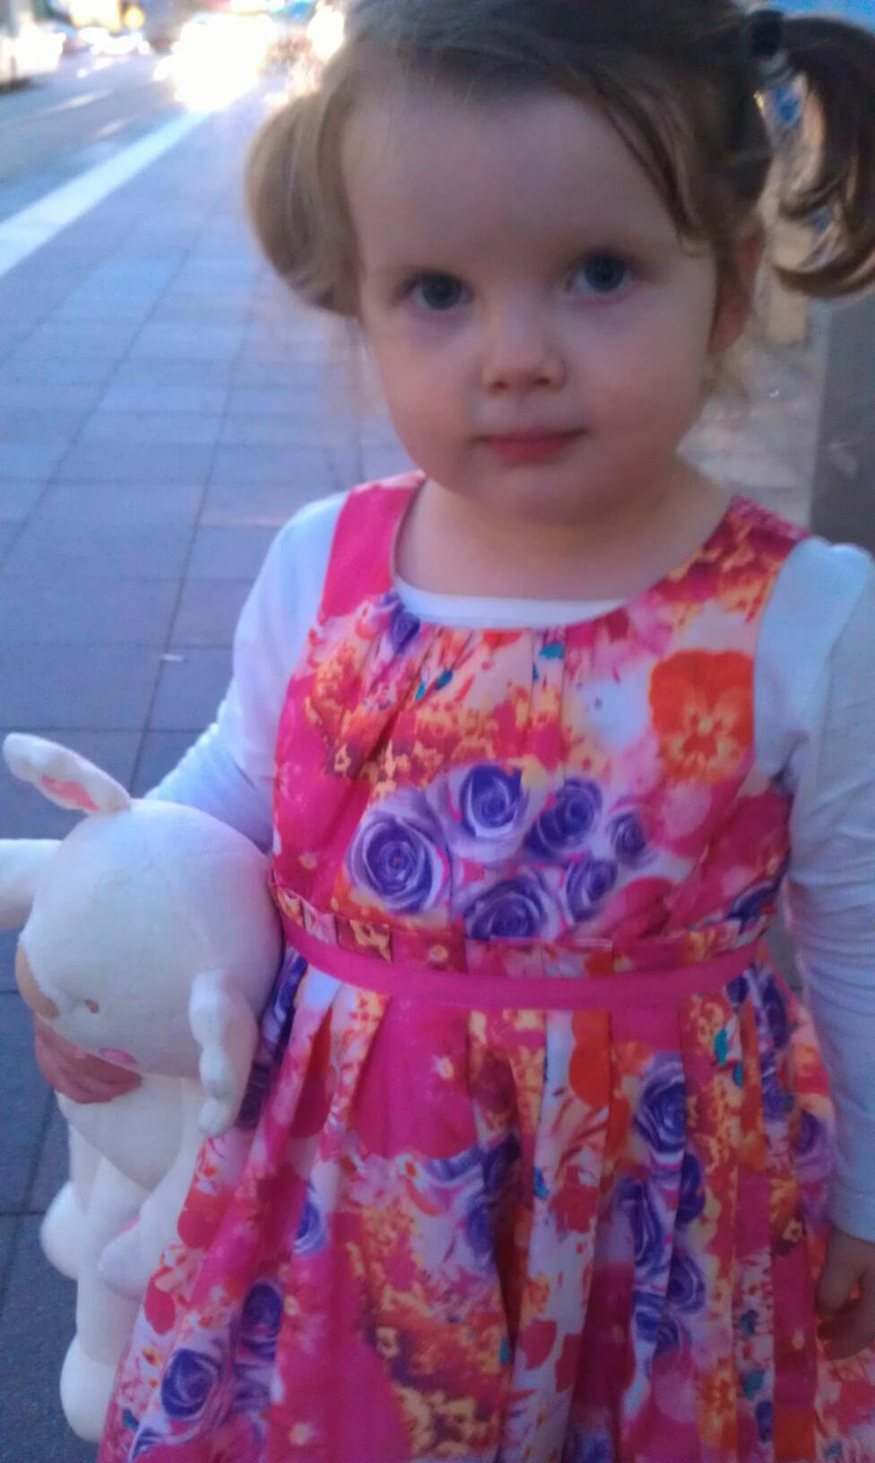
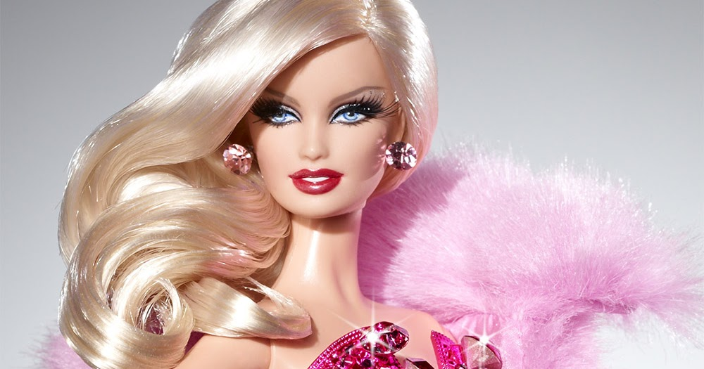
WHY MACHINE LEARNING?
This Photo by Unknown Author is licensed under CC BY-NC-ND

Slide 20

APPLICATIONS OF ARTIFICIAL
INTELLIGENCE?

Slide 21
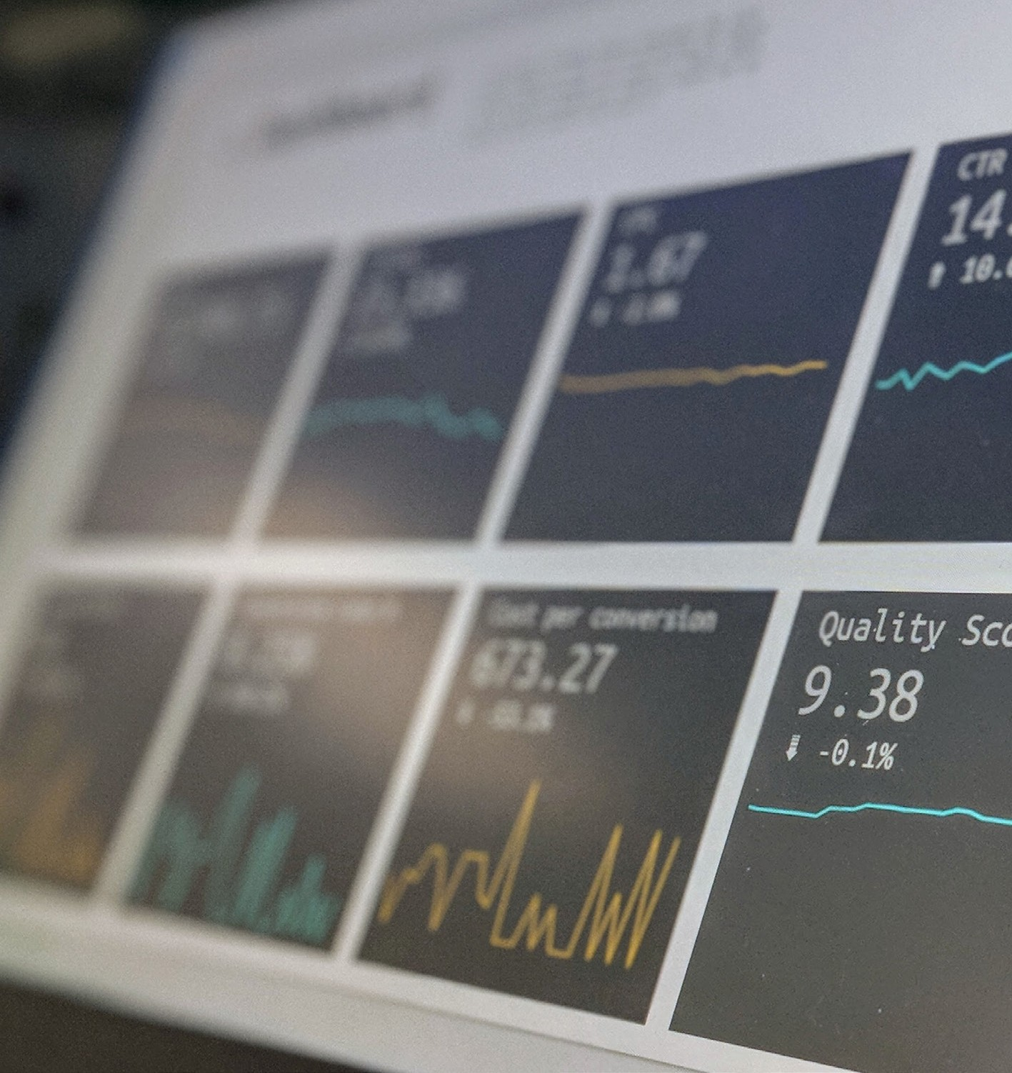
BUSINESS ANALYTICS
Modelling customer behaviour
Market segmentation Sales prediction
Customer churn prediction Logistics

Slide 22

Notes:
Add video

Slide 23
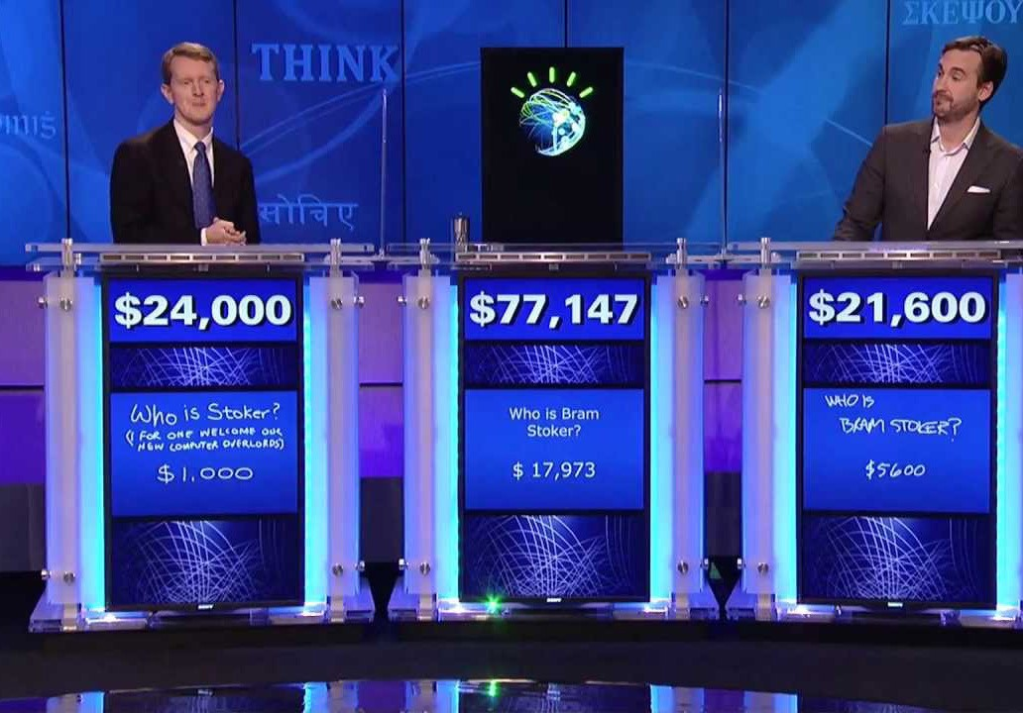
HEA LTH

Slide 24
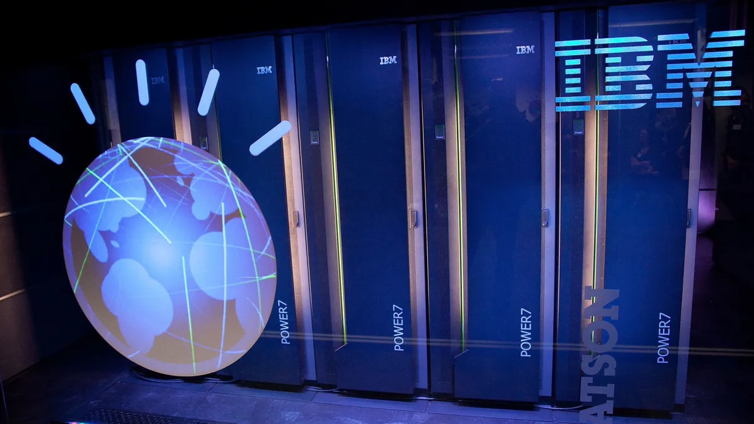
HEA LTH
IBM Watson reportedly recommeneded Cancer treatments that were ‘Unsafe and Incorrect’.

Slide 25
LARGE LANGUAGE MODELS
https://chat.openai.com/
Q: Who is Cook Medical in Brisbane, Australia?

Slide 26
LARGE LANGUAGE MODELS
https://chat.openai.com/
Q: Who is Cook Medical in Brisbane, Australia?
A:
Cook Medical is a global medical device company that develops, manufactures, and distributes a wide range of medical products for various medical specialties. The company has a presence in Brisbane, Australia, as part of its broader operations. Cook Medical focuses on providing innovative medical devices and solutions across several specialties, including:
Endoscopy: Devices used for gastrointestinal and other endoscopic procedures.
Interventional Radiology: Tools and products for minimally invasive image-guided procedures.
Urology: Products for treating urological conditions, such as kidney stones or urinary tract issues.
Vascular: Devices for vascular interventions, including stents and catheters.
Cook Medical's Brisbane office serves as a regional hub, supporting healthcare professionals in Australia and New Zealand by providing products, services, and training. The company is known for its commitment to research, development, and collaboration with healthcare providers to improve patient outcomes.

Slide 27
LARGE LANGUAGE MODELS
https://chat.openai.com/
Q: In the attached paper, there are four conditions. What are they?

Slide 28
LARGE LANGUAGE MODELS
https://chat.openai.com/
Q: I have 419 red applies and 201 green apples. I eat 300 of the apples. How many apples to I have left?
A: You have a total of 419 red apples + 201 green apples, which equals 620 apples initially.
If you eat 300 apples, subtract that from the initial count:
620 (initial count) - 300 (eaten) = 320 apples left.
So, you have 320 apples left after eating 300 of them.

Slide 29
LARGE LANGUAGE MODELS
https://chat.openai.com/
Q: How many red apples do I have left?
A: You initially had 419 red apples. After eating 300 apples from your total count, you have:
419 (initial red apples) - 300 (eaten) = 119 red apples left.
So, you have 119 red apples left.

Slide 30
LARGE LANGUAGE MODELS
https://chat.openai.com/
Q: How many green apples do I have left?
A: You initially had 201 green apples. After eating 300 apples from your total count, you have:
201 (initial green apples) - 300 (eaten) = -99 green apples.
It appears that you've eaten more green apples than you initially had, so you have a negative balance of 99 green apples. In reality, you don't have any green apples left, and you're left with only the remaining 119 red apples.

Slide 31
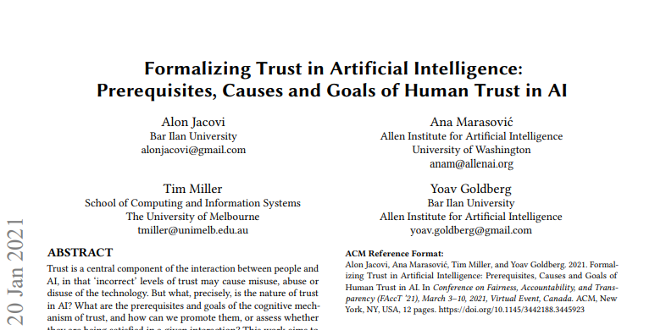
LARGE LANGUAGE MODELS
https://chat.openai.com/chat
Q: Who wrote the paper "Formalizing trust in artificial intelligence: Prerequisites, causes and goals of human trust in AI"?
A: The paper "Formalizing trust in artificial intelligence: Prerequisites, causes and goals of human trust in AI" was co-authored by Peter H. Kahn Jr., Batya Friedman, Elizabeth A. Lawless, and Nancy K. Roderer. It was published in the journal Philosophy & Technology in 2018.

Slide 32
ACTIVITY: HOW DO THESE LANGUAGE MODELS WORK?
“The woman ran up the ”

Slide 33


LARGE LANGUAGE MODELS
“baking”, 0.005%
“to”, 1.2%
“The”
“package”, 0.0001%
“the”, 1.9%
“woman”
“hill”, 0.002%
“myriad”, 0.000004%
.
“ran”
.
.
“up”
“stairs”, 1.9%
“gazpacho”, 0.00001%

Slide 34
LARGE LANGUAGE MODELS
“baking”, 0.005%
“to”, 1.2%
“The”
“package”, 0.0001%
“the”, 0.00001%
“woman”
“hill”, 10.8%
“myriad”, 0.000004%
“ran”
.
.
.
“up”
“stairs”, 6.9%
“gazpacho”, 0.00001%
“the”

Slide 35
HOW DO THESE LANGUAGE MODELS WORK?
“The woman ran up the ”
“What did the woman run up? ”

Slide 36
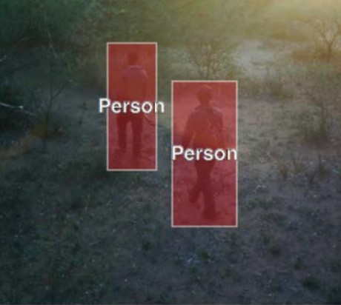
WILDLIFE PROTECTION
WPS field image after model successfully detects people through SILverbrane which resulted in teh detention of poachers
Photo courtesty of silverpond.com.au

Slide 37

WHAT ARE SOME OF THE ISSUES OF INTEREST

Slide 38
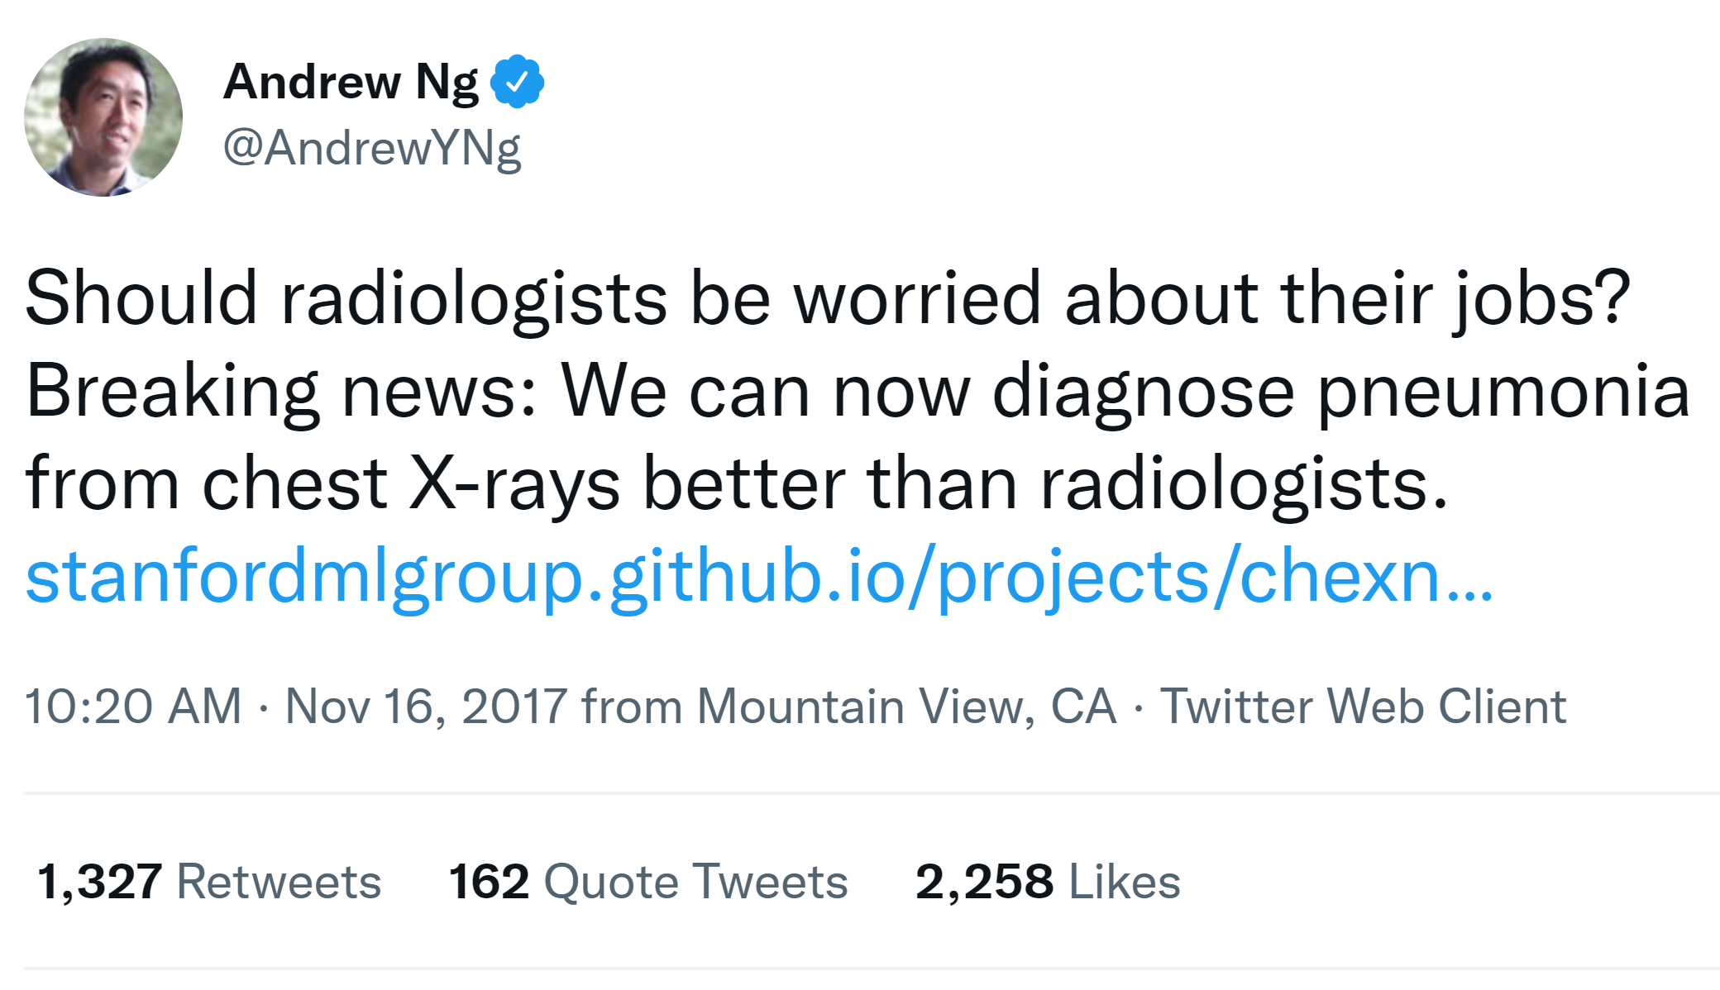
HYPE!

Slide 39

HYPE!

Slide 40
AUSTRALIAN ETHICAL AI PRINCIPLES
HUMAN, SOCIAL, AND ENVIRONMENTAL WELLBEING
FAIRNESS
HUMAN-CENTRED VALUES
RELIABILITY & SAFETY
PRIVACY & SECURITY
CONTESTABILITY
ACCOUNTABILITY
TRANSPARENCY AND EXPLAINABILITY

Slide 41
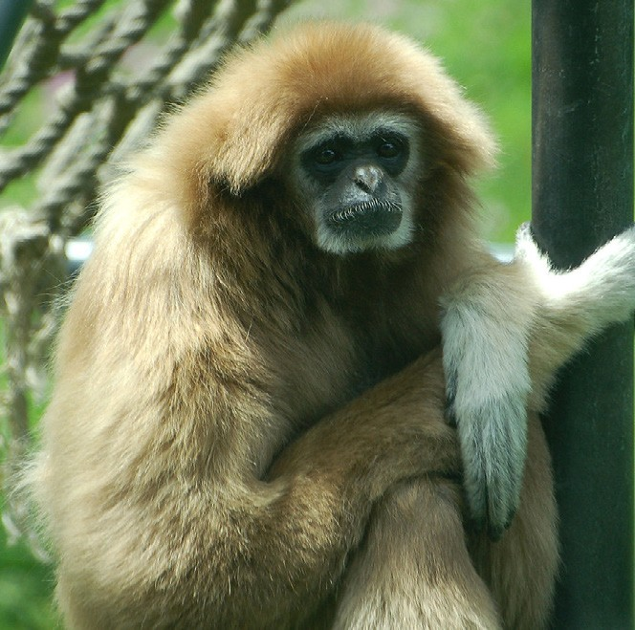
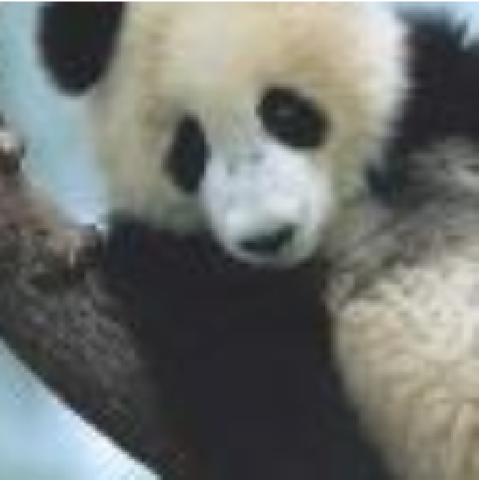

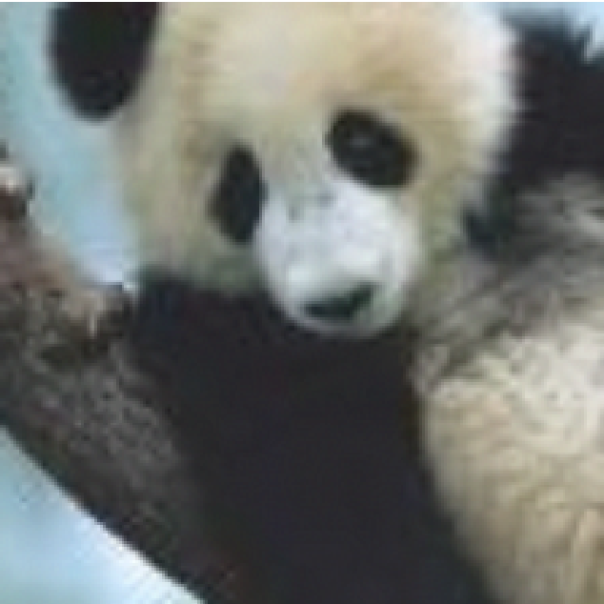
RELIABILITY AND SAFETY
+
=
“panda”
57.7% confidence
Noise x 0.007
“gibbon”
99.3% confidence
Source: Explaining and Harnessing Adversarial Examples, Goodfellow et al.
Notes:
Fix background

Slide 42
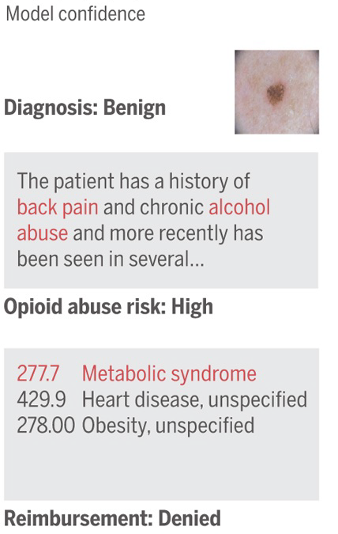
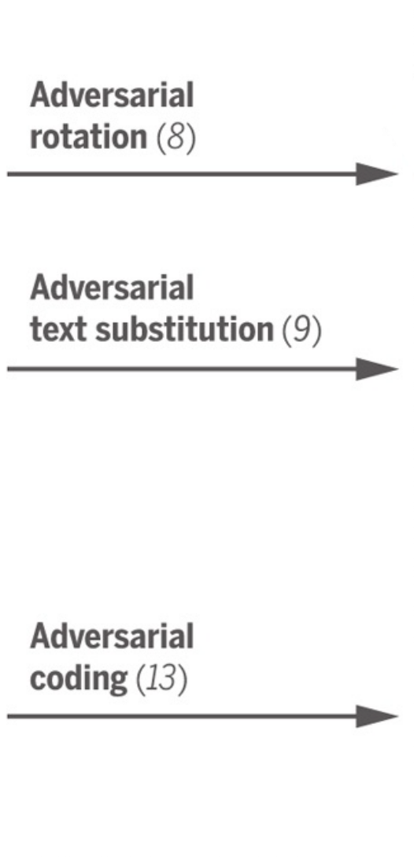
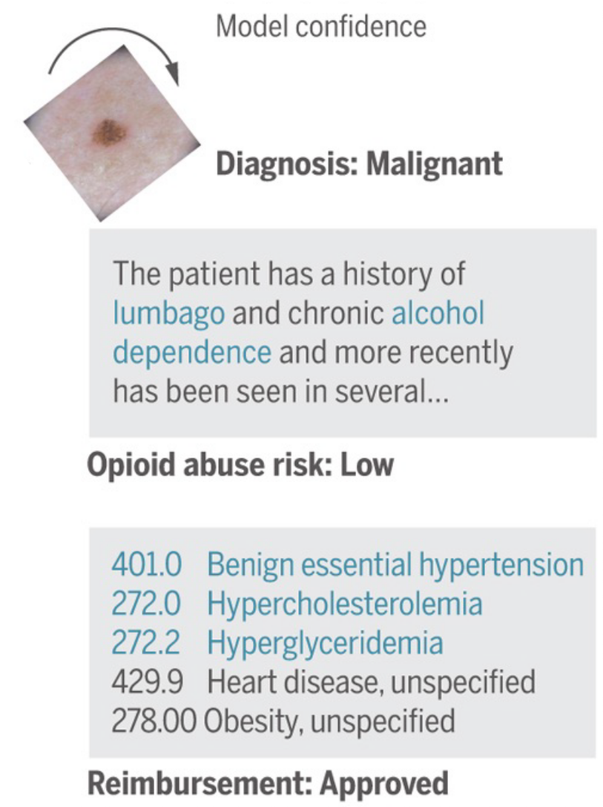
RELIABILITY AND SAFETY
Source: It’s disturbingly easy to trick AI into doing something deadly, Samuel. www.vox.com/future-perfect/2019/4/8/18297410/ai-tesla-self-driving-cars-adversarial-machine-learning
Notes:
Fix background

Slide 43
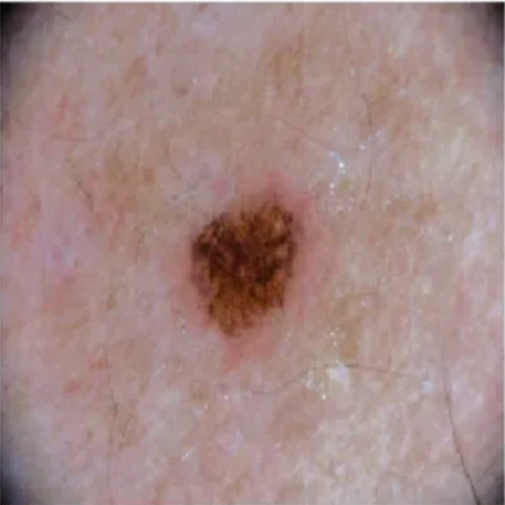
RELIABILITY AND SAFETY
Diagnosis: Benign
Diagnosis: Malignant

Slide 44
RELIABILITY AND SAFETY
Diagnosis: Benign
Diagnosis: Malignant
277.7
Metabolic syndrome
277.7
Metabolic syndrome
429.9
Heart disease, unspecified
429.9
Heart disease, unspecified
278.0
Obesity, unspecified
278.0
Obesity, unspecified
Reimbursement: Denied
Source: It’s disturbingly easy to trick AI into doing something deadly, Samuel. www.vox.com/future-perfect/2019/4/8/18297410/ai-tesla-self-driving-cars-adversarial-machine-learning

Slide 45
RELIABILITY AND SAFETY
Diagnosis: Benign
Diagnosis: Malignant
277.7
Metabolic syndrome
401.0
Benign essential hypertension
429.9
Heart disease, unspecified
272.0
Hypercholesterolemia
278.0
Obesity, unspecified
272.2
Hyperglyceridima
429.9
Heart disease, unspecified
278.0
Obesity, unspecified
Reimbursement: Denied
Reimbursement: Approved
Source: It’s disturbingly easy to trick AI into doing something deadly, Samuel. www.vox.com/future-perfect/2019/4/8/18297410/ai-tesla-self-driving-cars-adversarial-machine-learning

Slide 46
SHORTCUTS IN LEARNING: LANGUAGE MODELS AND “READING”
Passage: … Glynis bc-nj-zimmer-profile-2-takes-byt rahana Furnio Yikushiro dragnea ihadon Bjorkman/mix … seventh-largest embarrassed jeopardy hilariously Masahisa Habari bajram-8-to-24-duke/Meredith acceding … koidu Iraqis 2:32:21 //www.ironmanitive.com/ Sagawa Kyubin clean international 90-meter Kakuei Tanaka seven-paragraph 577,610 gold-lpga-jpn partner, un-appointed ue mazzei Canada-u.s.
Passage: … Glynis bc-nj-zimmer-profile-2-takes-byt rahana Furnio Yikushiro dragnea ihadon Bjorkman/mix … seventh-largest embarrassed jeopardy hilariously Masahisa Habari bajram-8-to-24-duke/Meredith acceding … koidu Iraqis 2:32:21 //www.ironmanitive.com/ Sagawa Kyubin clean international 90-meter Kakuei Tanaka seven-paragraph 577,610 gold-lpga-jpn partner, un-appointed ue mazzei Canada-u.s.
Question: Shin Kanemaru, the gravel-voiced back-room boss who died on Thursday, aged 81, goes down in history as Japan’s most corrupt post-war politician after ______
Answer: Kakuei Tanaka
Source: Kaushik, D. and Lipton, Z.C., 2018. How Much Reading Does Reading Comprehension Require? A Critical Investigation of Popular Benchmarks. In Proceedings of the 2018 Conference on Empirical Methods in Natural Language Processing (pp. 5010-5015).

Slide 47
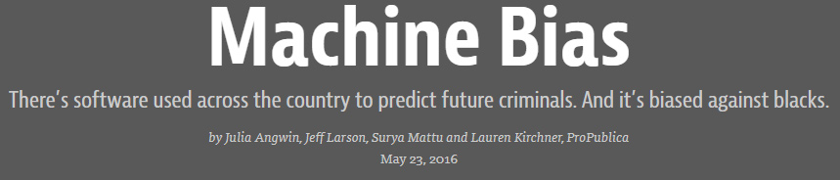
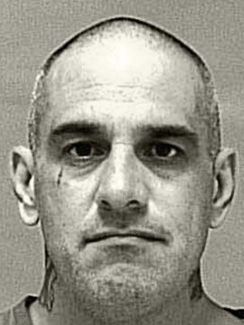
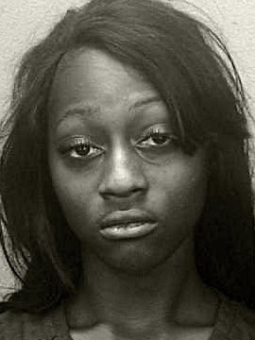
FAIRNESS
Vernon Prater
Prior Offenses:
2 armed robberies
1 attempted armed robbery
Brisha Borden
Prior Offenses:
4 juvenile misdemeanours
Risk: Low (3)
Risk: High (8)

Slide 48
FAIRNESS
Amazon drops secret AI recruiting tool that showed bias against women

Slide 49
TRANSPARENCY AND EXPLAINABILITY
EXPLAINABILITY
Understanding reasoning behind each decision
TRANSPARENCY
PROVABILITY
Understanding of AI model decision making
Mathematical certainty behind decisions

Slide 50
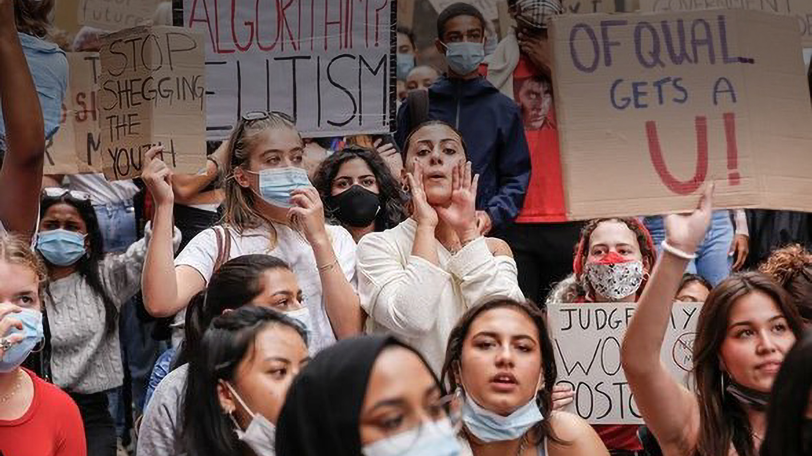
CONTESTABILITY

Slide 51
WHAT IS THE FUTURE OF WORK?

Slide 52
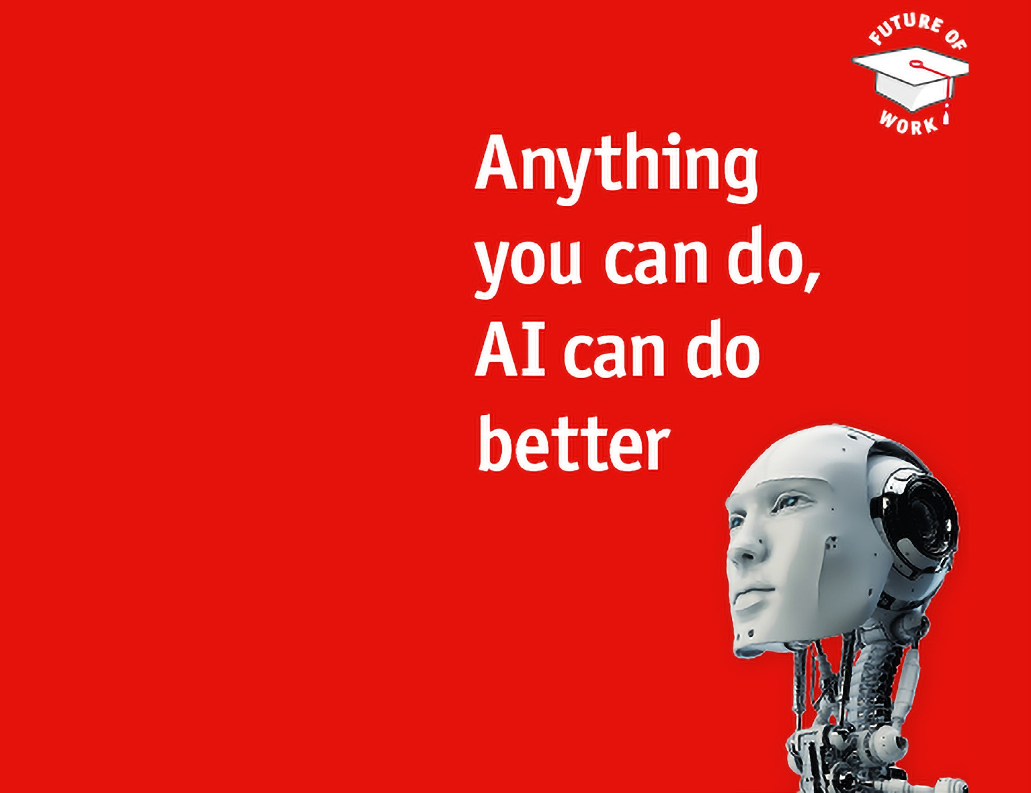
FUTURE OF WORK
“Machines will be capable, within twenty years, of doing any work a man can do”
HERBERT SIMON
(1965)
The Economist, June 2016

Slide 53
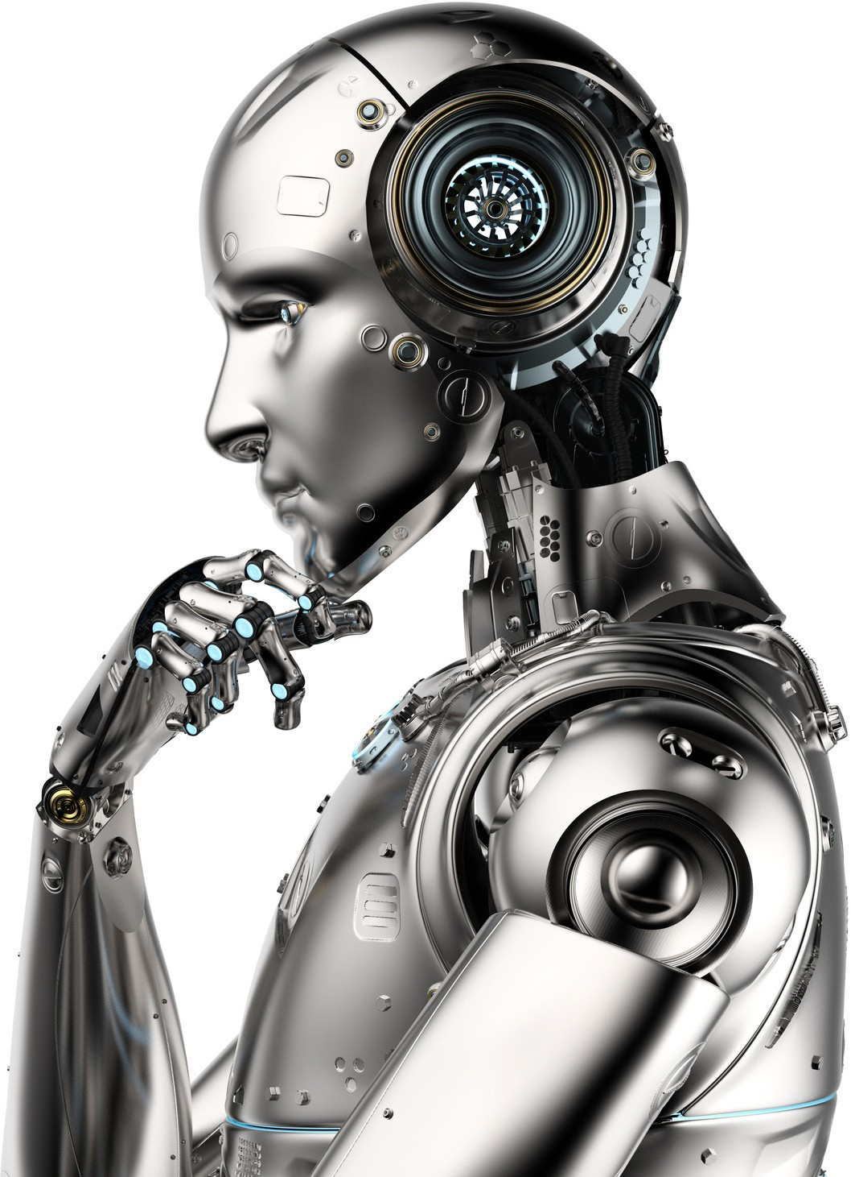
FUTURE OF WORK
Instead of asking:
“What will computers (not) be able to do?”
Ask:
“What will we simply not
let them to do?”

Slide 54
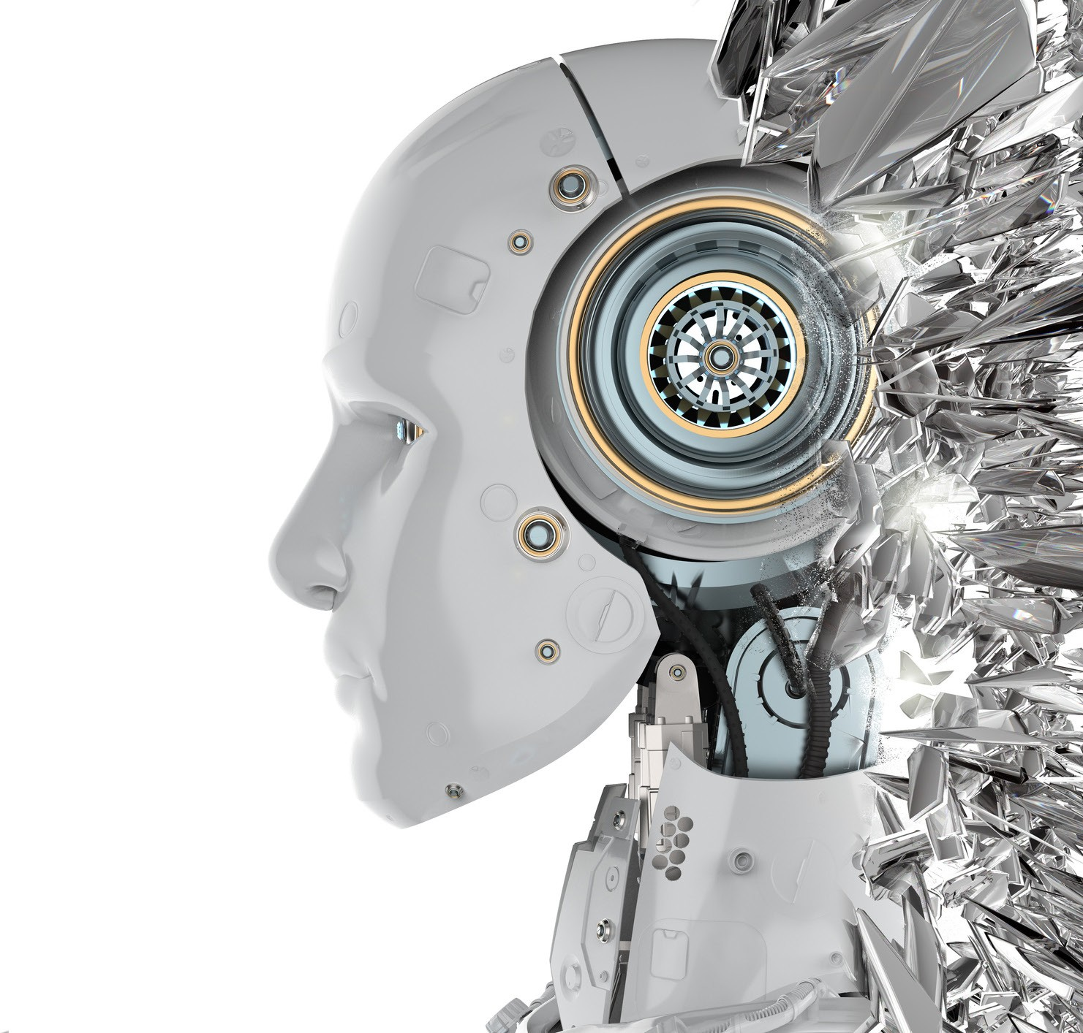
FUTURE OF WORK
INTERACT
EMPATHISE
TELL STORIES
INNOVATE & CREATE

Slide 55
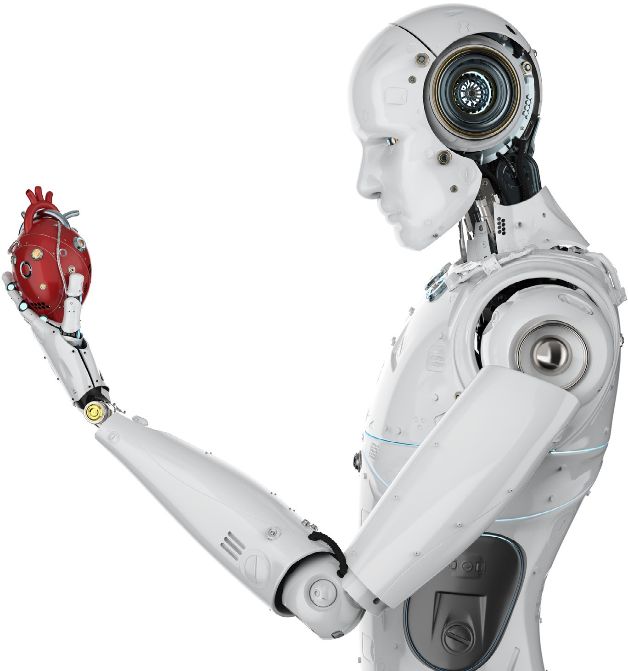
TIPS FOR FUTURE PROOFING
GET TECHNICAL
GET SOCIAL
BE NICE TO
ARTIFICIAL INTELLIGENCE

Slide 56
HOW SHOULD I
LEAD IN THE ERA OF ( ETHICAL) AI?

Slide 57
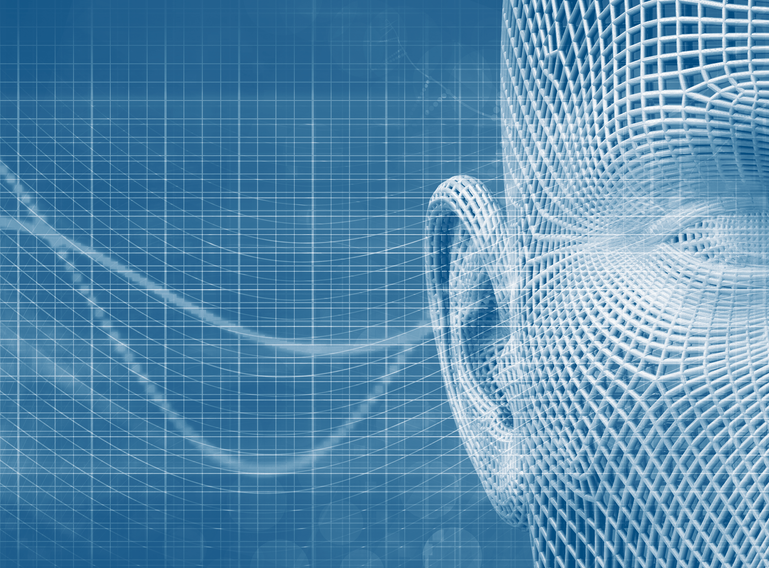
CHIEF ETHICS OFFICER
You are the chief ethics officer of your team
Your team looks to you for guidance and as an example

Slide 58
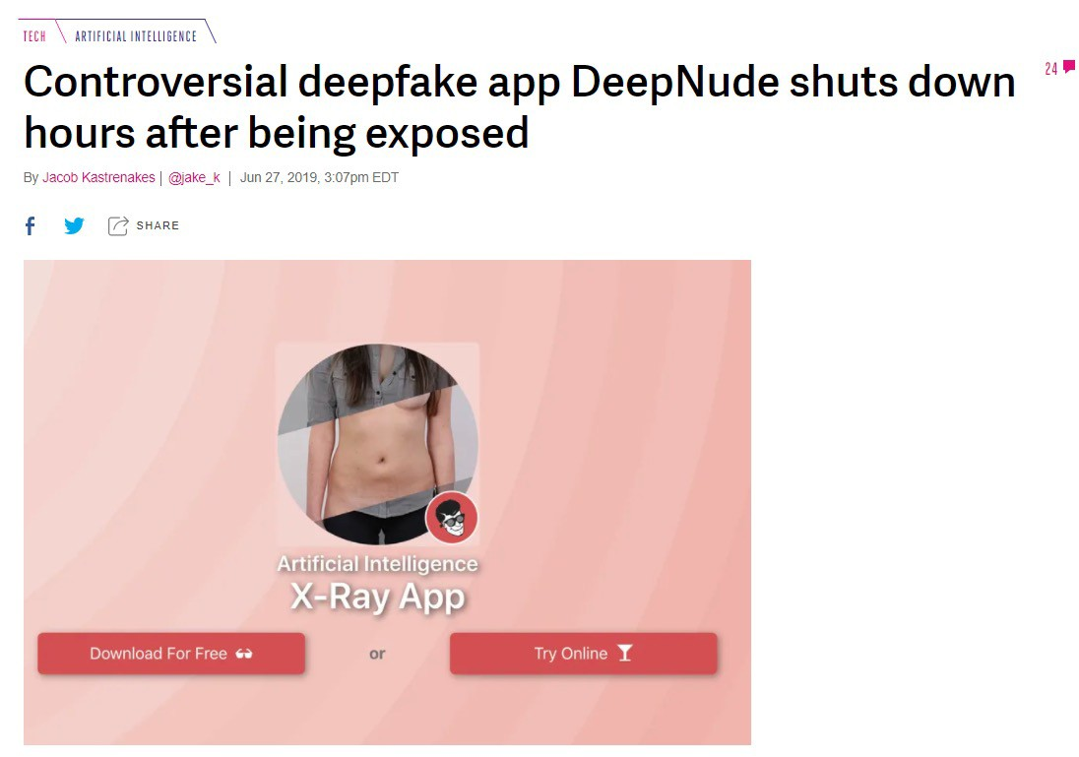
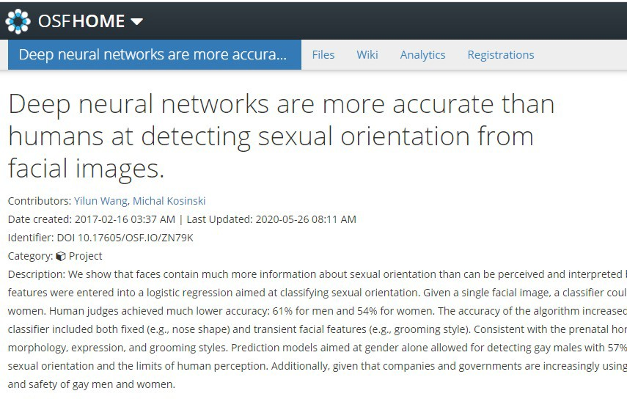
OUGHT BEFORE CAN

Slide 59

PEOPLE ARE NOT
INSTRUMENTAL GOODS

Slide 60

DATA
Data is more important than algorithms.
Data is not neutral, but! bias is not just a data problem

Slide 61
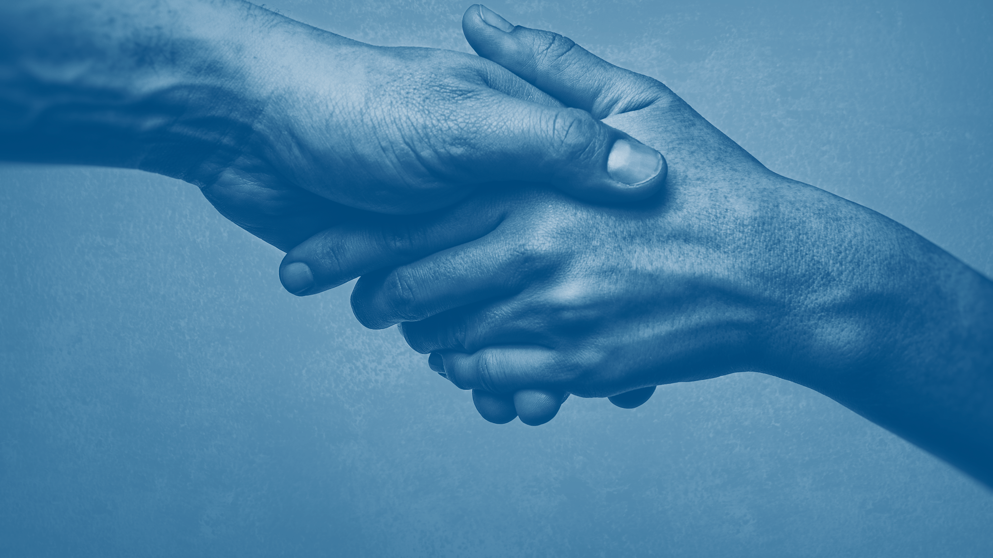
CLARITY, HONESTY, AND TRUST
Building trust starts with expectations
Be clear and honest about what your system can and cannot do

Slide 62
KEY TAKEAWAYS
ARTIFICIAL INTELLIGENCE is AUTOMATED COMPUTER PROGRAMMING
MACHINE LEARNING IS STATISTICS, NOT MAGIC
ISSUES: RELIABILITY, SAFETY, and ETHICS

Slide 63
KEY TAKEAWAYS
ARTIFICIAL INTELLIGENCE
IS NOT MAGIC
BUT,
THIS CREATES ISSUES
AI = automated computer programming
Reliability
Machine learning = computing + statistics
Safety
Sometimes learning is easier than programming
Ethics

Slide 64
THANK YOU
Tim Miller
School of Electrical Engineering and Computer Science
The University of Queensland, Australia E: timothy.miller@uq.edu.au
T: @tmiller_uq W: https://uqtmiller.github.io/

